Slide 1
Interactive Data Visualisation
Intro Lecture - Dr Ruairi O’Reilly

Slide 2
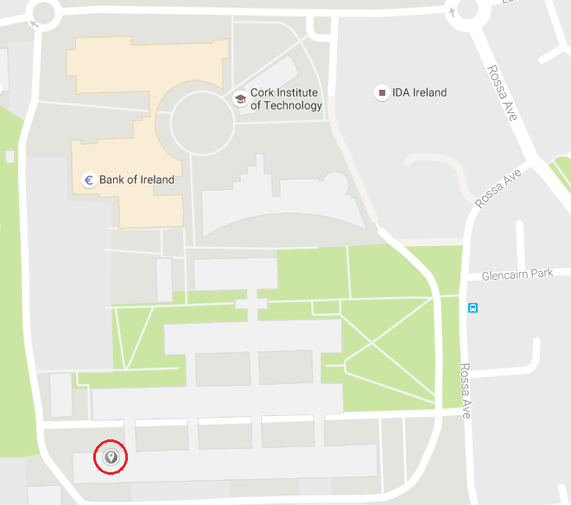
Contact Details
E-mail: ruairi.oreilly@cit.ie
Office: A284
Contact: What to do with general problems - interact with one another! Personal problems/issues then e-mail me!
Office in A block

Slide 3
COMP8054 Learning Outcomes
Full module descriptor available online
Discuss data visualisation techniques and principles.
Appraise the suitability of a variety of visualisation techniques for the web.
Apply a data visualisation technique to a data source.
Evaluate the suitability of interactive functionality incorporated into a visualisation technique.
Combine suitable data visualisation techniques and data sources for web-based viewing.

Slide 4
What is Interactive Data Visualisation?
Data visualisation - modern form of visual communication that presents data via a graphical format.
Interactivity - being able to alter or change that graphical presentation based on how a user interacts with it.

Slide 5
What I expect you to take away from Interactive Data Visualisation
An appreciation for web based data visualisation technology and an understanding of the critical role it plays in modern web applications.
how to identify and apply a suitable visualisation technique for a data source.
It will enable you to create visualisations of data for the web as well as the ability to incorporate interactive functionality to enhance data analysis.

Slide 6

Recommended Reading
“D3.js in Action”, 2nd Edition,
Elijah Meeks, November 2017

Slide 7

Recommended Reading SDH3!!!
“Eloquent Javascript” (free pdf available). An excellent resource to make you a better programmer. Work through this consistently on your own time!
Complete this js tutorial by Monday Week!

Slide 8
Assessment 100% CA
Assessment 1 (20%): Essay - Describe and discuss an appropriate data visualisation technique for a specified data domain. Provide a rationale for both the visualisation technique and the interactivity features chosen. (W7)
Assessment 2 (30%): Project - Develop a suitable web-based visualisation for a chosen data source. Incorporate interactive functionality that enhances the analysis of that visualisation when viewing online. (W12)
Assessment 3 (50%): Formal Exam - End of Semester Formal Examination.

Slide 9
What you know that I’m aware of?
html
css
Javascript (highly recommend getting to grips with this asap)
Java
Pug
Node
Vue or React

Slide 10
What content will we cover?
Data Visualisation Theory: Targeting appropriate visual elements on a page, mapping values in the data domain to visual domain, human visualisation interaction - adding computation steering to visualisations.
Visualisation Techniques: Charts, Plots & Layouts - graphical representations of data: Line Charts, Area Charts, Bubble Charts, Bar Charts, Scatterplots, Scaling Data, Axes, Geomapping (GeoJSON, Paths, Projections). Layouts: Pie Layout, Stack Layout, Force Layout.
Data Interactivity: Updating data, Interaction via Event Listeners, Transitions,Updating scales, Updating axes, Binding Event listeners, Grouping SVG Elements, Mouse Events, Multi touch devices, Zoom and pan behaviour, Drag behaviour.

Slide 11
What content will we cover?
Data practices: Generating page elements, chaining methods, representing data in programming constructs, binding data, drawing with data, transition and animation support.
Technologies: Web Standards, Canvas, Rendering the Box Model, CSS, Javascript, SVG, D3.js, JSON.

Slide 12
What I expect from you
Be committed to excellence
Explore the technologies we’re discussing
Enjoy the process
More points derived from my experiences with you in S1
Stay on top of your work from today!
No excuses, as of today you know your going to have a project in Data Visualisation - do tutorials on D3.js, Canvas focusing on visualisation of JSON datasets. Then you will be competent when completing the project.
Essays, I like drafts and to discuss the idea in advance of seeing it as it results in better quality material being written.
There is an exam at the end of this module.

Slide 13
Online Resources - more work for you!
W3C Schools - A great learning resource for html, js, css, php, mysql and much more.
Mozilla Developer Network - A great resource for beginners, intermediates and advanced web developers!
I’ll build a list of specific topics/niches as we go on.

Slide 14
Any questions?
Coming up next…… SVG

Slide 15
Online Resources!
Edward Tufte homepage
Personal course page: http://roreilly.ie/node/38
W3C Schools - A great learning resource for html, js, css, php, mysql and much more.
Mozilla Developer Network - A great resource for beginners, intermediates and advanced web developers!
I’ll build a list of specific topics/niches as we go on.
https://d3js.org/

